Slide 1

SMART BRAILLE TECH
ADITYA ENGINEERING COLLEGE(A)
Batch No : 18
Under the Guidance of
Dr.V. Ravi Kishore Veluri.,Ph.D
Associate Professor
Department of CSE
Aditya Engineering College (A)
Presented By
1.NANI SAMIREDDY (21A95A0517)
2.KRISHI JAIN (20A91A05G0)
3.SUBHRA KHANDA (20A91A05I6)
4.VASIREDDY PHANINDRA (20A91A05I9)

Slide 2
Contents
Abstract
Introduction
Problem statement
Aim & Objective of the project
Existing System and Disadvantages
Proposed system and Advantages
Literature Survey Comparison Table
Requirement Analysis(SRS/HRS)
Project Flow
Technology/Algorithm Used
Modules
Detailed Design
UML Diagrams
Testing and Test cases
Results
Conclusion and scope for future work
References

Slide 3
ABSTRACT
The Smart Braille Tech project endeavors to create an innovative solution to enhance digital accessibility for blind individuals. By developing a wireless braille keyboard utilizing an ESP32 microcontroller with Bluetooth support, this project aims to provide an affordable and user-friendly interface for blind users to interact with digital devices. The keyboard features six input buttons, each representing a braille character, facilitating seamless communication with cross-platform systems including Windows, macOS, and Android. Through extensive research, development, and implementation of advanced technologies and algorithms, this project seeks to overcome the limitations of existing braille input methods, offering improved accessibility and empowering blind individuals to navigate the digital world with ease and efficiency.

Slide 4
INTRODUCTION
In today's digital age, accessibility to technology is paramount for individuals with visual impairments. However, traditional methods of interfacing with digital devices often pose challenges for the blind community. The Smart Braille Tech project emerges as a beacon of innovation, aiming to revolutionize digital accessibility through the development of a wireless braille keyboard. Leveraging the capabilities of the ESP32 microcontroller and Bluetooth technology, this project seeks to provide a seamless and intuitive interface for blind users to interact with computers and mobile devices. By addressing the limitations of existing braille input methods and embracing cross-platform compatibility, this initiative endeavors to empower blind individuals with the tools they need to navigate and thrive in the digital world.

Slide 5
AIM & OBJECTIVE
Aim: The aim of the Smart Braille Tech project is to develop a wireless braille keyboard that enhances accessibility for individuals with visual impairments.
Objective:
Design a compact wireless braille keyboard with six input buttons, resembling the six-dot braille representation.
Implement Bluetooth connectivity to facilitate wireless communication with digital devices.
Ensure cross-platform compatibility with Windows, macOS, and Android operating systems, enabling seamless integration with various devices.
Develop intuitive software algorithms to map braille input to corresponding keystrokes for enhanced user experience.
Conduct extensive testing and refinement to ensure the keyboard's reliability, usability, and accessibility for blind individuals.
Provide an affordable and user-friendly solution that empowers blind users to navigate and interact with digital devices independently and efficiently.

Slide 6
LITERATURE SURVEY
S.No | Reference Paper Title | Purpose | Drawbacks
1 | ZAYNAB ZEINEDDINE, SAMAR SINDIAN, NOUR AL HODA AHMAD, GEORGE ISMAIL "Low Cost Electronic Brailler", 2020 | To review existing braille input methods and their effectiveness in digital accessibility. | Limited discussion on cross-platform compatibility.
2 | K V Shalini, Keerthi B, Manasa B, Padmashree, Ashritha KG "Design and Implementation of Digital Braille System for The Visually Impaired", 2020 | To discuss about design of USB braille keyboard | Lacks detailed analysis of wireless solutions.
3 | Mukhriddin Arabboev, Shohruh Begmatov, Ziyokhon Rakhimov, Khushnud Gaziev, Khabibullo Nosirov, "Design of an External USB Braille Keyboard for Computers", 2022 | To evaluate different braille keyboard designs for mobie devices in terms of usability and effectiveness. | Focuses primarily on physical design aspects, lacking discussion on wireless connectivity.

Slide 7
LITERATURE SURVEY
S.No | Reference Paper Title | Purpose | Drawbacks
4 | Kazi Toukir Ahmed, Md Zesun Ahmed Mia "Ultra Low Cost, Low Power, High Speed Electronic Braille Device for Visually Impaired People", 2024 | Affordability, efficiency, and speed. By making the device significantly cheaper than existing options, the paper aims to dramatically increase accessibility for people in developing countries and those with limited resources. Additionally, a low-power design would extend battery life and potentially allow for solar charging, making the device highly portable. Finally, the paper proposes a high-speed design by optimizing the refresh rate of the braille display, enabling users to read at faster speeds. | Affordability with features like high refresh rates, which can be expensive. Additionally, ensuring the device is durable despite a low-cost design and guaranteeing compatibility with various digital text formats are potential limitations. The paper might propose solutions or areas for further research to address these limitations, but it likely focuses more on the overall concept and its potential impact on the lives of visually impaired people, rather than delving into the intricate engineering details.

Slide 8
EXISTING SYSTEMS:
Keyboards like hable provides braille language input to computer devices.
It provides cross platform support.
DISADVANTAGES:
The affordability is very low.
Product availability is very low.
For Visually disabled persons in India, It is hard to effort them. Even if they can effort the availability is very low

Slide 9
PROPOSED SYSTEM:
Introducing the Smart Braille Tech keyboard and its features:
Wireless Braille keyboard that supports cross platform accessibility.
With affordable cost where common people in India can easily buy it.
Compact design with 9 input buttons representing braille characters.
Wireless operation via Bluetooth.
Cross-platform compatibility with Windows, macOS, and Android.
Haptic feedback for activities and incorrect inputs.

Slide 10
ADVANTAGES:
Improved accessibility for blind individuals.
Affordable and portable solution.
Seamless Cross-Platform Compatibiltiy.
Tactile Feedback Mechanism.
Wireless Bluetooth Connectivity.
Haptic Feedback for Error Correction.
Enhanced user experience with digital devices.

Slide 11
System Requirements
Hardware Requirements:
Software Requirements:
Micro-Controller : ESP32
Other Components : Push buttons, Coin vibration motor, Breadboards, Jumper wires, USB cable
Framework : Adrunio
Libraries : BleKeyboard
IDE : Adrunio IDE, PlatformIO

Slide 12
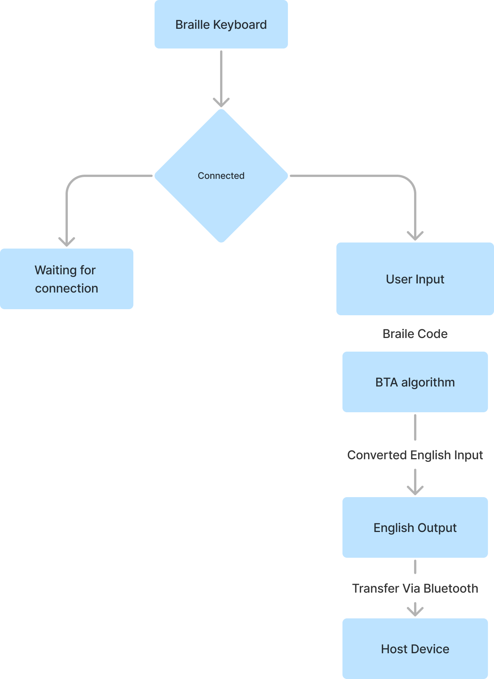
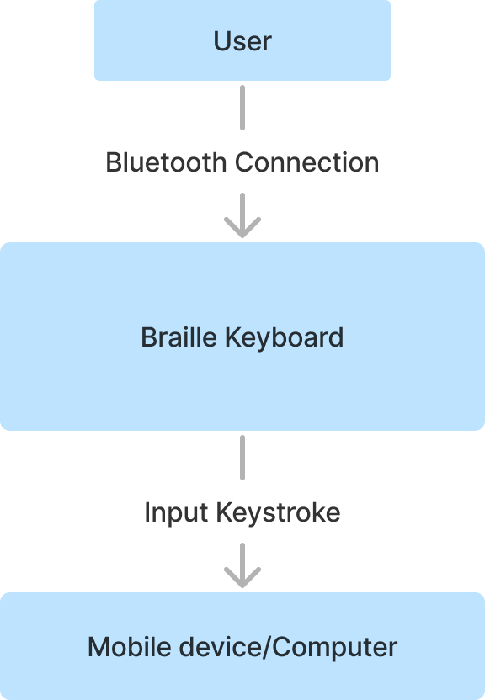
Project Flow

Slide 13
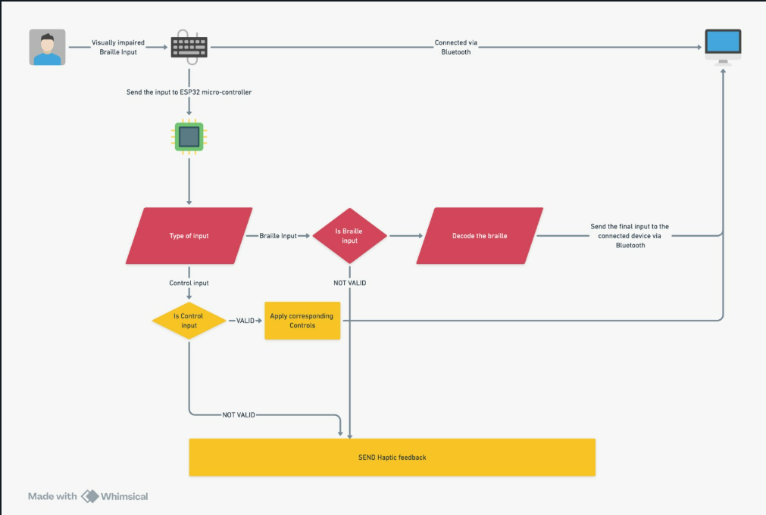
Architecture

Slide 14
Technology/Algorithm Used
Detailing the technologies and algorithms utilized in the project:
ESP32 microcontroller programming in C++.
Bluetooth communication protocol.
Braille character mapping algorithm.

Slide 15
MODULES
1.ESP32 Processing: The ESP32 Processing Module is essential for the Braille Pad project. It interprets user input from physical and control buttons, translates button presses into binary braille patterns, and manages mode changes between input modes such as ToNumber, ToCharacter, and ToCapital.
2.Bluetooth Connection Module: Establishes and manages the Bluetooth Low Energy (BLE) connection between the ESP32 microcontroller and external devices
3.User Input (Braille) Module: Captures and processes user input in braille format from the physical braille pad buttons.
4.Translation Module: Converts braille input into corresponding text characters or control commands based on the current mode and user preferences

Slide 16
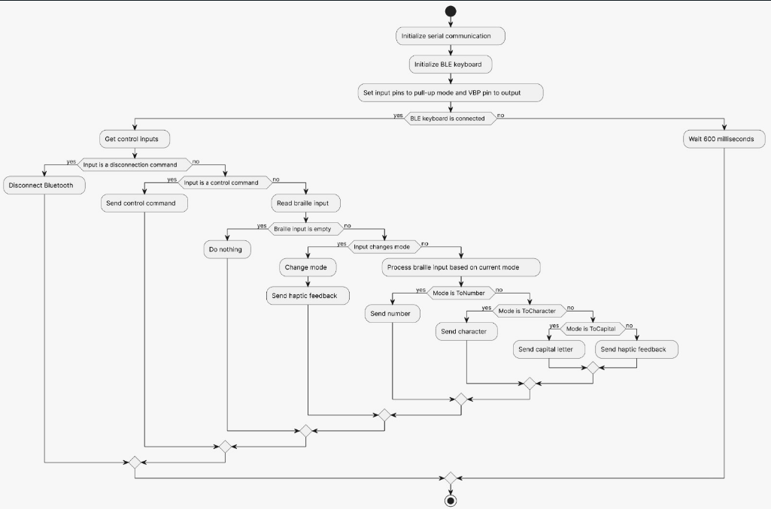
DETAILED DESIGN
Flowchart Diagram
The following shown diagram is the flowchart diagram of the proposed model.
This figure shows the flow of the entire project from starting stage to the ending stage.

Slide 17
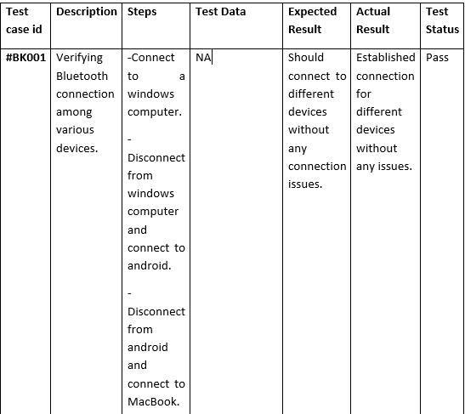
TESTCASES

Slide 18
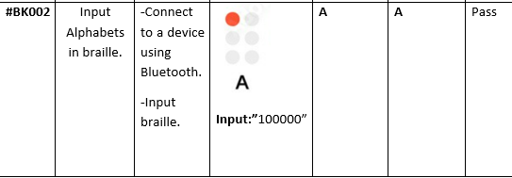

Slide 19
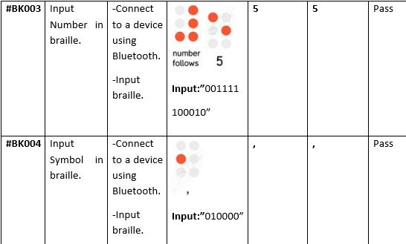

Slide 20
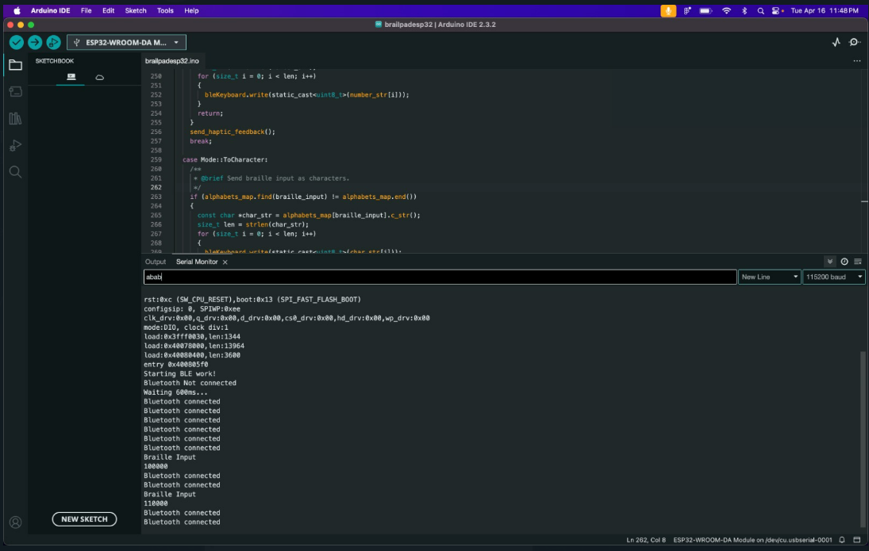
PICTURES AND RESULTS

Slide 21
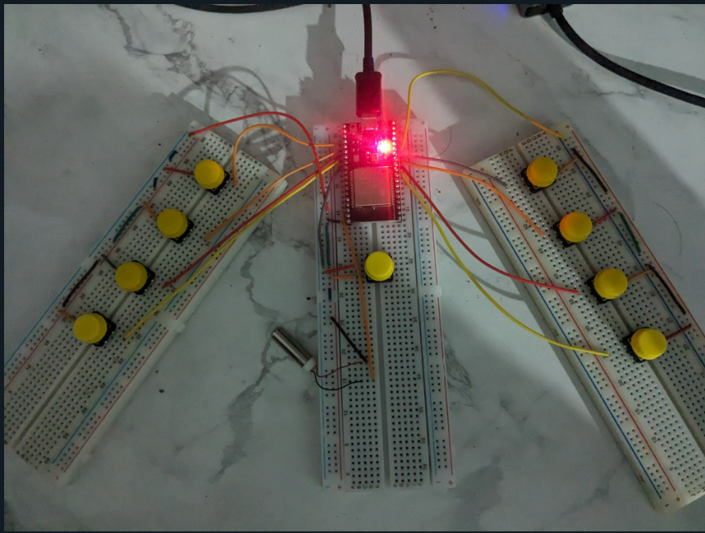

Slide 22
CONCLUSION
The Smart Braille Tech project represents a significant step forward in enhancing digital accessibility for individuals with visual impairments. Through the design and implementation of a wireless braille keyboard, this project addresses the limitations of existing braille input methods and empowers blind users to navigate and interact with digital devices more efficiently. By leveraging the capabilities of the ESP32 microcontroller and Bluetooth technology, the keyboard offers a compact, user-friendly interface that is compatible with various operating systems, including Windows, macOS, and Android. While existing literature provides valuable insights into wireless braille keyboards, our project aims to build upon this knowledge to create a solution that prioritizes reliability, usability, and affordability for blind individuals. By bridging the accessibility gap between traditional braille methods and modern digital technologies, the Smart Braille Tech project ultimately seeks to promote greater independence and inclusion in the digital realm for individuals with visual impairments.

Slide 23
Future Scope
The Smart Braille Tech project lays a strong foundation for further advancements in digital accessibility for individuals with visual impairments. Some potential future directions and enhancements include:
Enhanced Features: Incorporating additional features such as haptic feedback or voice recognition to further improve the user experience and accessibility of the braille keyboard.
Integration with Assistive Technologies: Collaborating with assistive technology developers to integrate the braille keyboard seamlessly with screen readers, magnifiers, and other assistive tools, thereby enhancing overall accessibility.
Localization and Language Support: Expanding language support and localization options to cater to diverse user populations worldwide, ensuring that the braille keyboard meets the needs of users in different regions.

Slide 24
Table for student contribution
Sno | TASKS | 21A95A0517 | 20A91A05G0 | 20A91A05I6 | 20A91A05I9
1. | Literature Survey |   ✓ | ✓ | ✓
2. | Problem Formulation | ✓
3. | Requirements gathering | ✓ | ✓ | ✓ | ✓
4. | Resource Estimation | ✓ | ✓ | ✓ | ✓
5. | Documentation | ✓ | ✓ | ✓
6. | PPT Preparation | ✓ | ✓ |  | ✓

Slide 25
References
K V Shalini, Design and Implementation of Digital BrailleSystem for The Visually Impaired https://www.academia.edu/42782983/Design_and_Implementation_of_Digital_Braille_System_for_The_Visually_Impaired
ZAYNAB ZEINEDDINE, Low Cost Electronic Brailler, https://www.academia.edu/104355562/Low_Cost_Electronic_Brailler
Wikipedia, https://en.wikipedia.org/wiki/English_Braille#:~:text=English%20Braille%2C%20also%20known%20as,than%20one%20letter%20in%20print.
3.Mukhriddin Arabboev, Shohruh Begmatov, Ziyokhon Rakhimov, Khushnud Gaziev, Khabibullo Nosirov, "Design of an External USB Braille Keyboard for Computers", 2022
4. Kazi Toukir Ahmed, Md Zesun Ahmed Mia "Ultra Low Cost, Low Power, High Speed Electronic Braille Device for Visually Impaired People", 2024

Slide 26
6. Kazi Toukir Ahmed, Md Zesun Ahmed Mia "Ultra Low Cost, Low Power, High Speed Electronic Braille Device for Visually Impaired People", 2024
7. T. Ribeiro AlvesC. Pinto PereiraT. Cerqueira de Jesus "LITERA BRAILLE: PROTOTYPING AND DEVELOPMENT OF LOW-COST DEVICE BASED ON BRAILLE TYPEWRITER", 2023
8. Sana Shokat, Rabia Riaz, Sanam Shahla Rizvi, Khalil Khan, Farina Riaz, and Se Jin "Analysis and Evaluation of Braille to Text Conversion Methods", 2020
9. Shohruh Begmatov, Mukhriddin Arabboev, Sardor Vakhkhobov, "Design and development of a folding type braille keyboard", 2023
10. John Lloyd Suarez, Danielle Joy Pueblo, Jamaica Pablita Padida, Justine Quilantang A Cost-Effective 6-Key Wooden Braille Keyboard for Visually Impaired Individuals", 2023
11. Joy Protim; Abu Talha Md. Abdullah; Ahmed Iqbal Pritom; Mehrab Zaman Chowdhury "BADHON: A High Performing Keyboard Layout for Physically Impaired People", 2019
12. Nikhil Khare, Om Sharan, Manikandan J "Design and Development of a Digital Scribe for Visually Challenged Students", 2020

